Slide 1
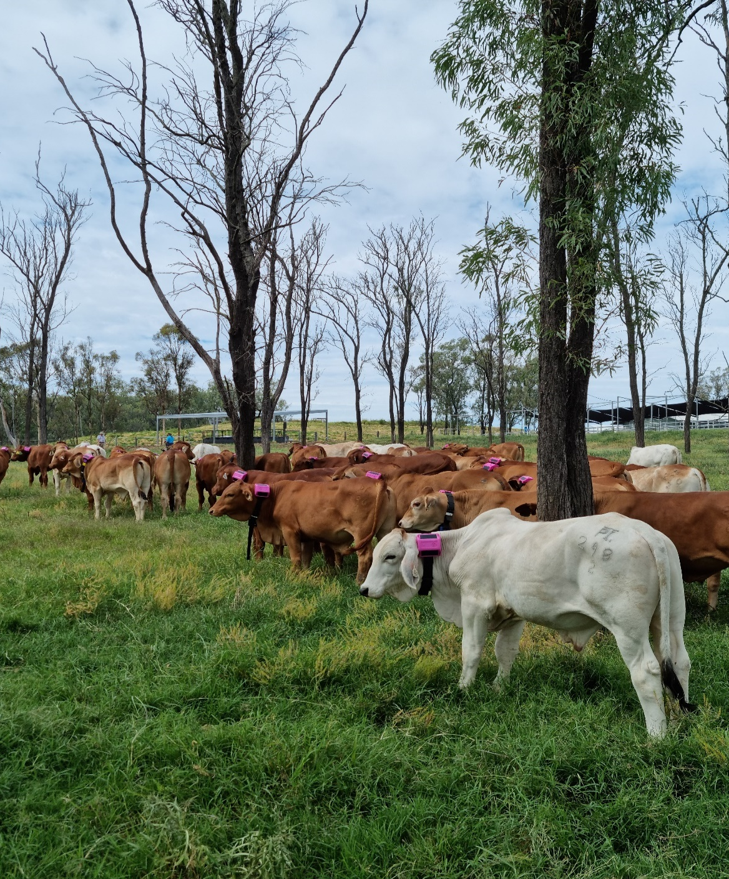
Predication of Daily Weight Gain with Cattle Behaviour and Daily Activity Using Triaxial Accelerometer Data
Dr. Shuwen Hu
shuwen.hu@rmit.edu.au
27 Nov 2025

Slide 2
Who here has a Fitbit/Apple Watch?

Slide 3
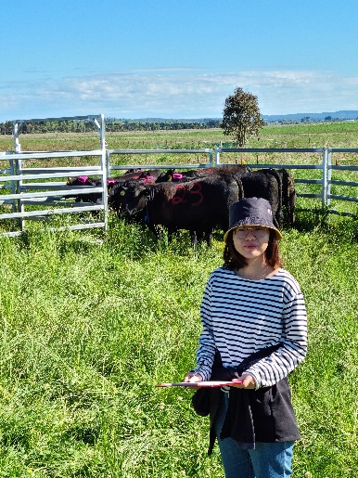
Why Sensors on Cattle?
Objectively
It isn’t based on someone’s opinion
Remotely
We don’t need to be there watching
Continuously
Animals can be monitored 24 / 7
Broadly
Lots of animals in typical production environments
More reliably than a postdoc with a clipboard
Notes:
Many important animal production traits are not easily measured at scale
-growth
-feed efficiency
-health and wellbeing
-reproduction

Slide 4
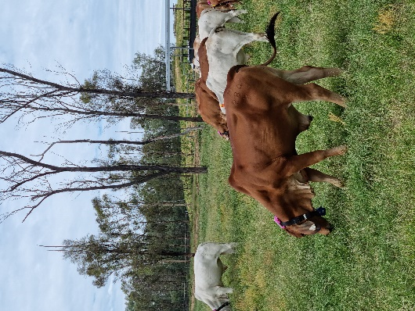
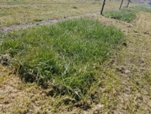
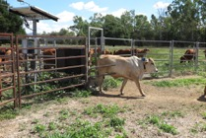
Correlating animal behaviour to pasture intake and efficiency
Can animal behaviour be interpreted from inertial sensor signals?
Does a relationship exist between behaviours and production?
Health, Welfare
Behaviour
Intake
Bite size
Efficiency
Ratio
Production
(e.g. weight)
Bite rate

Slide 5
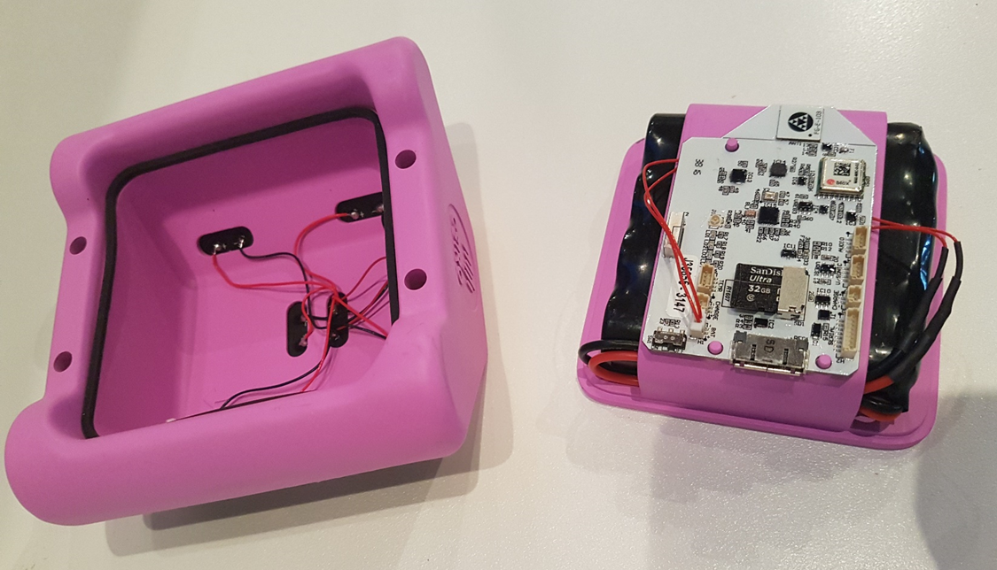
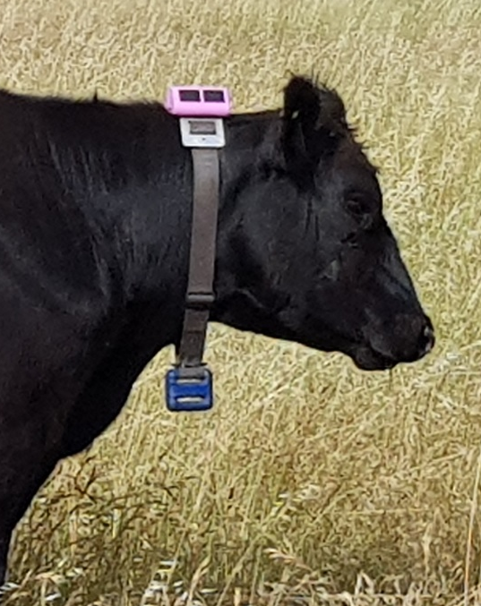
The Basic eGrazor
Solar panels to recharge
Control board
Worn as a collar
Batteries
Rugged cowproof case. To stop it getting smashed…but with fashionable pink colour.
Counterweight to keep it upright

Slide 6
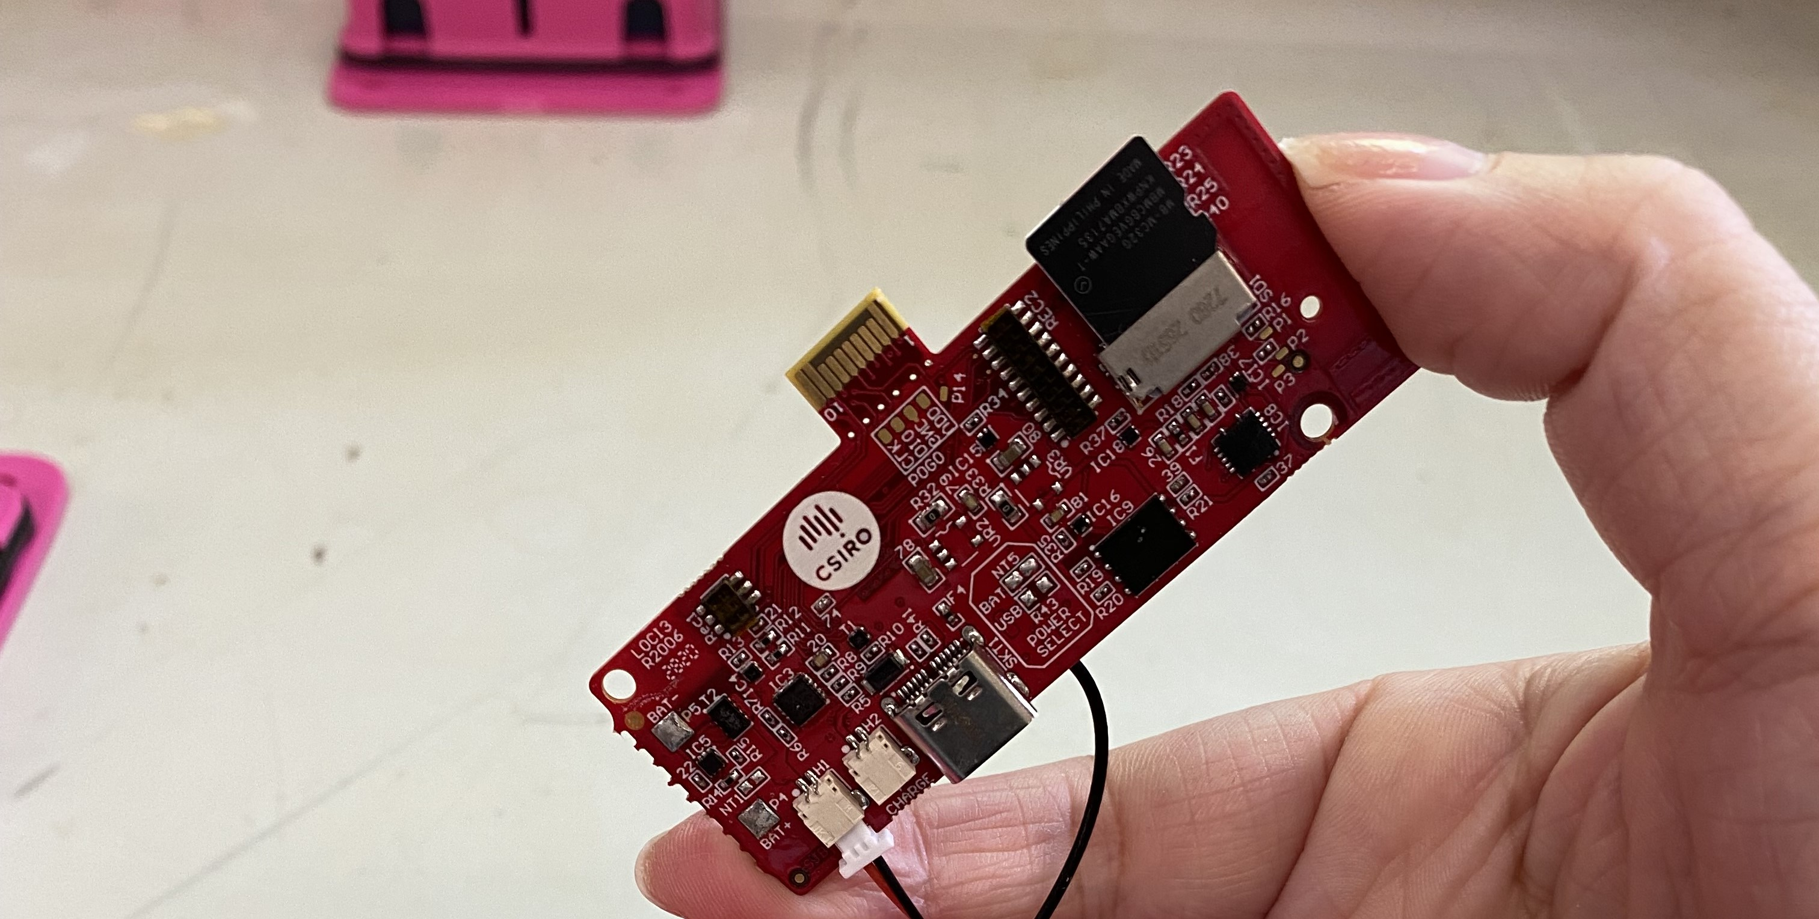
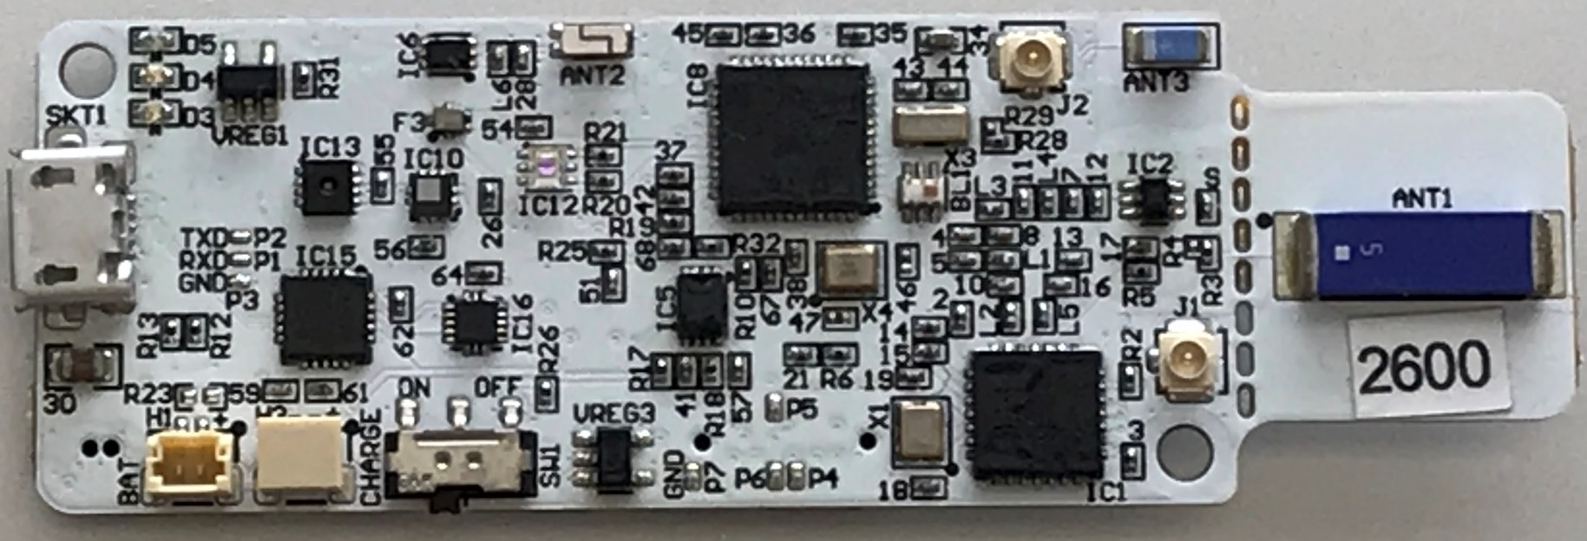
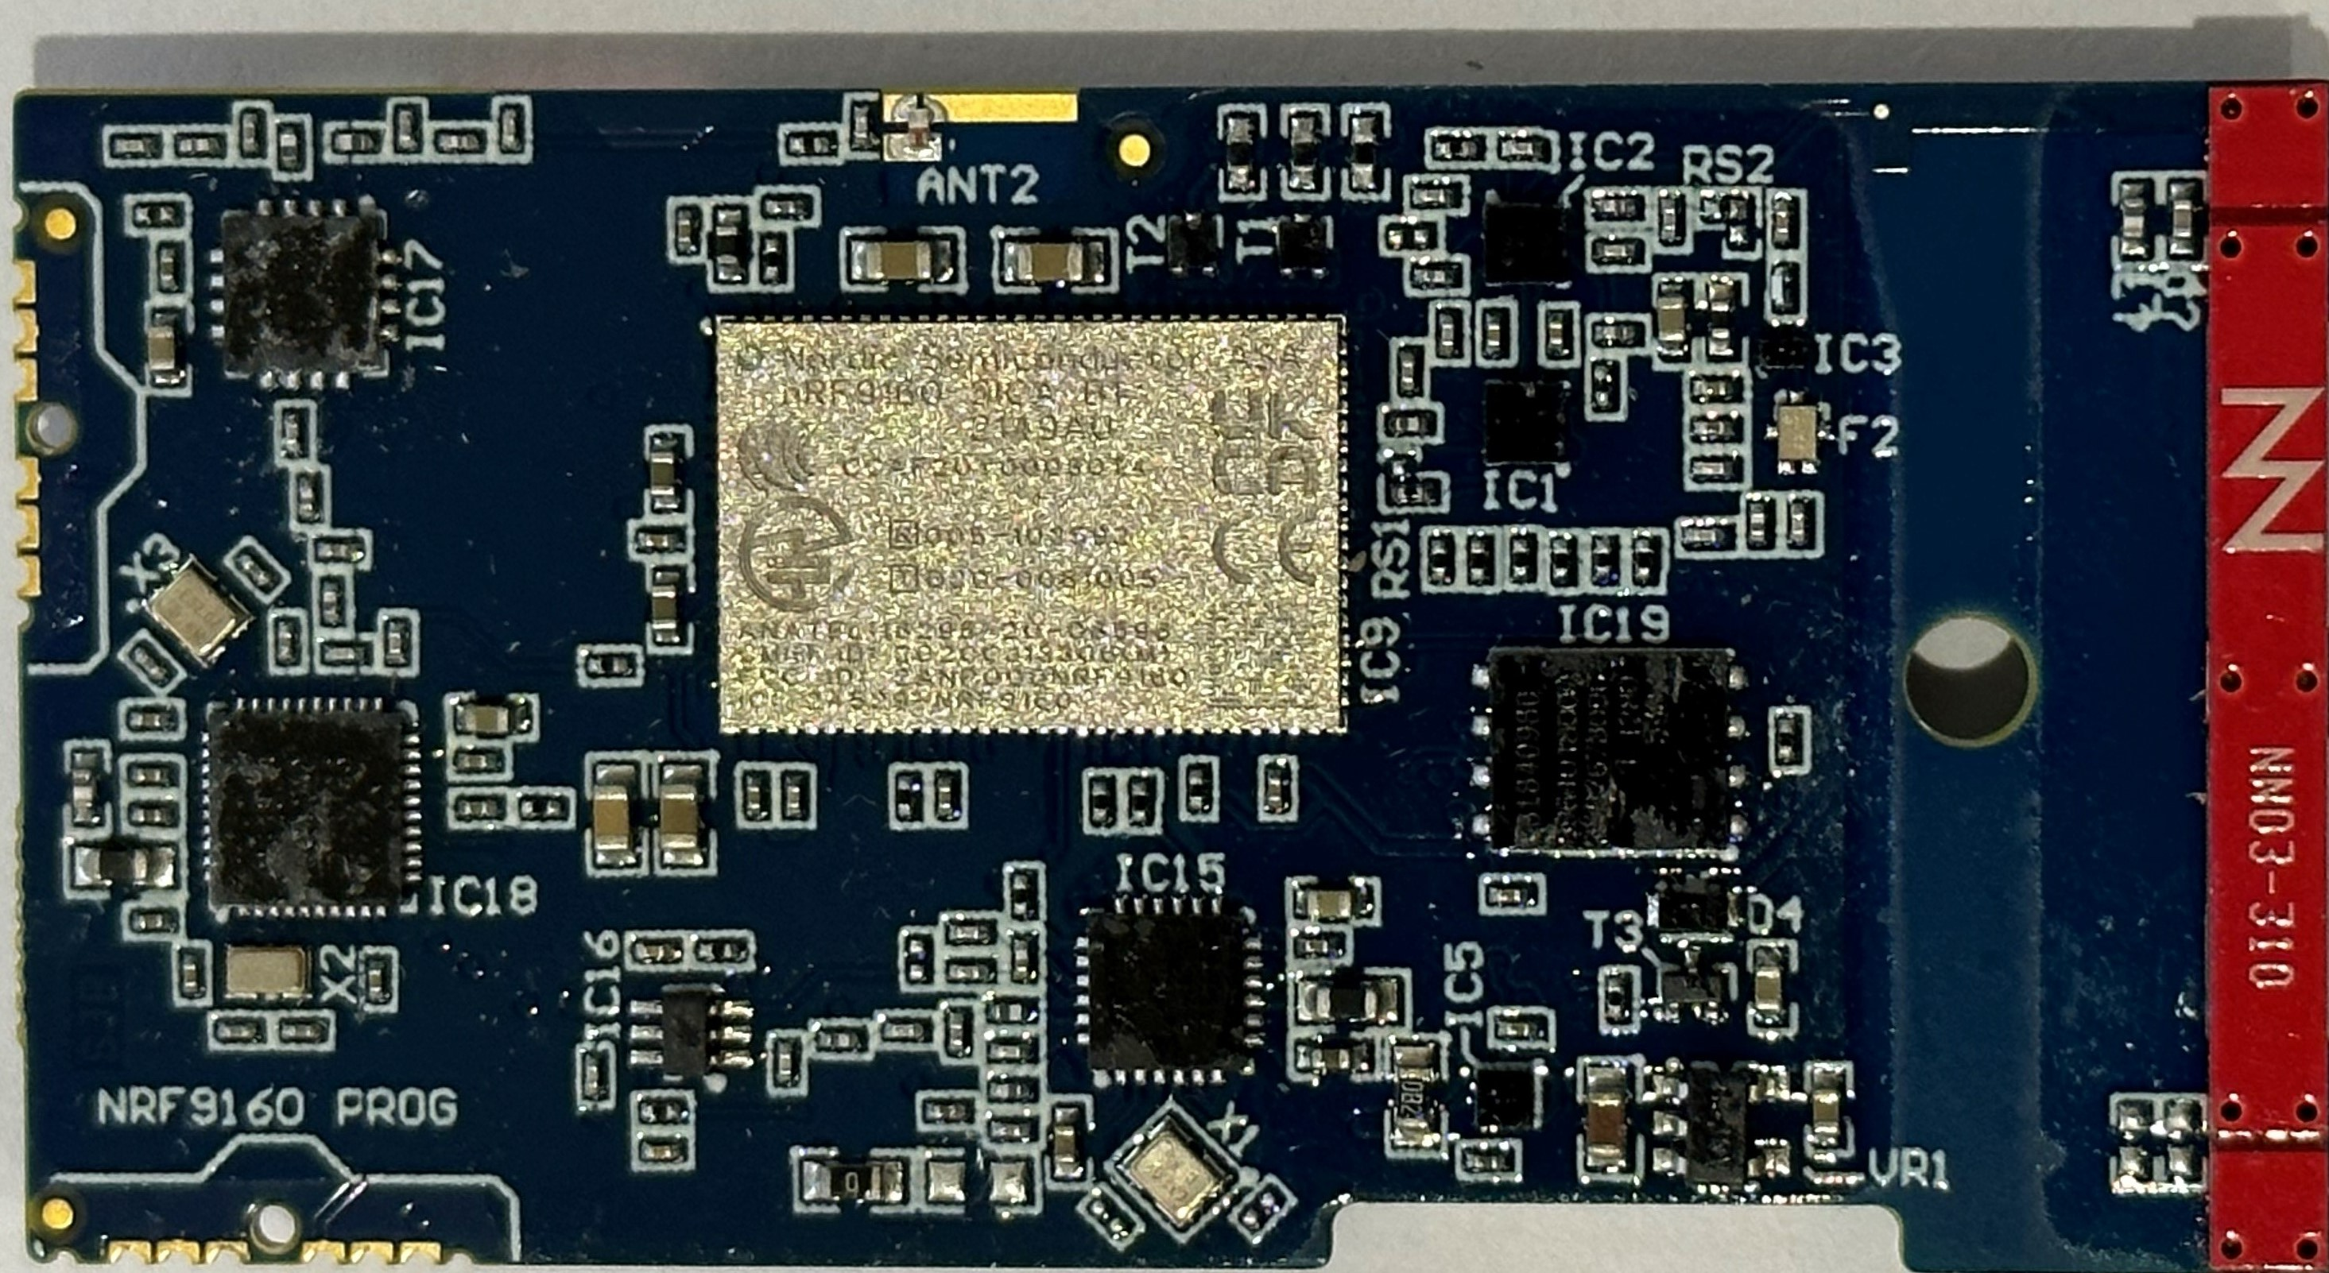
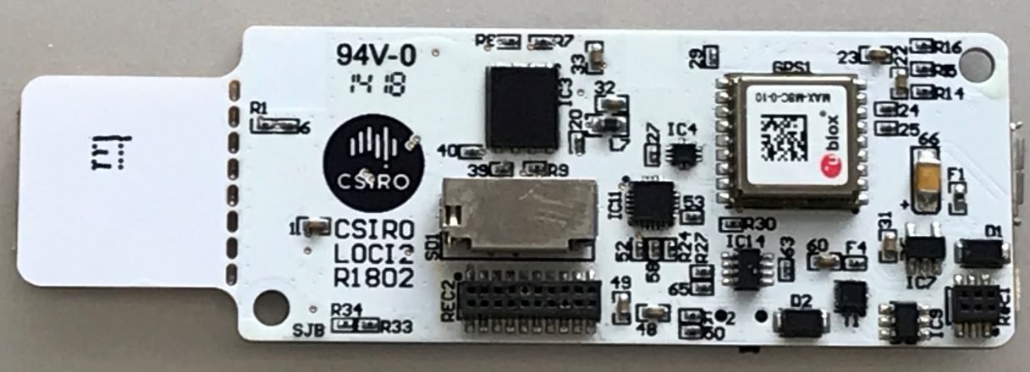
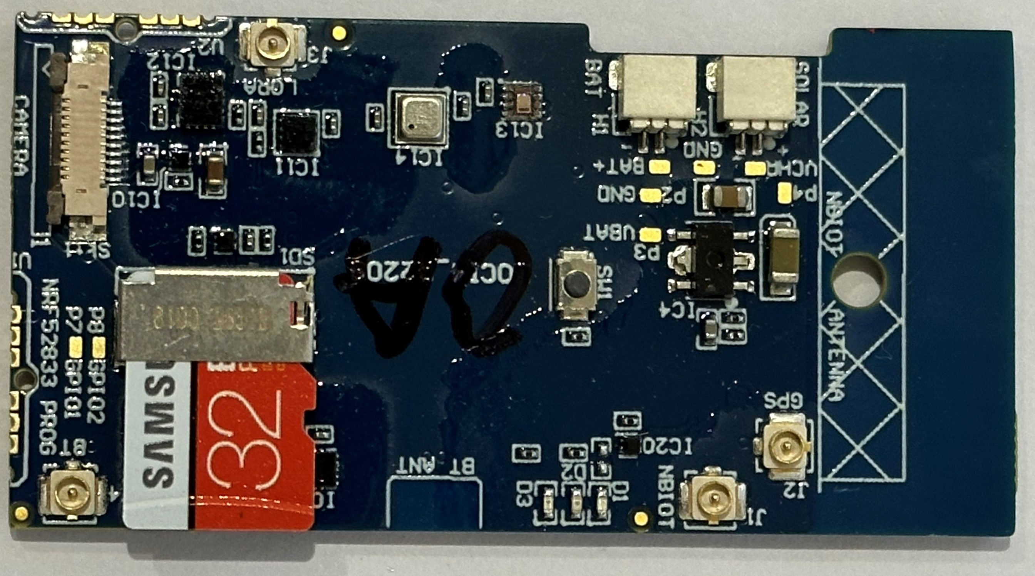
What technology is in eGrazor?
LOCI3
LOCI2
LOCI4

Slide 7
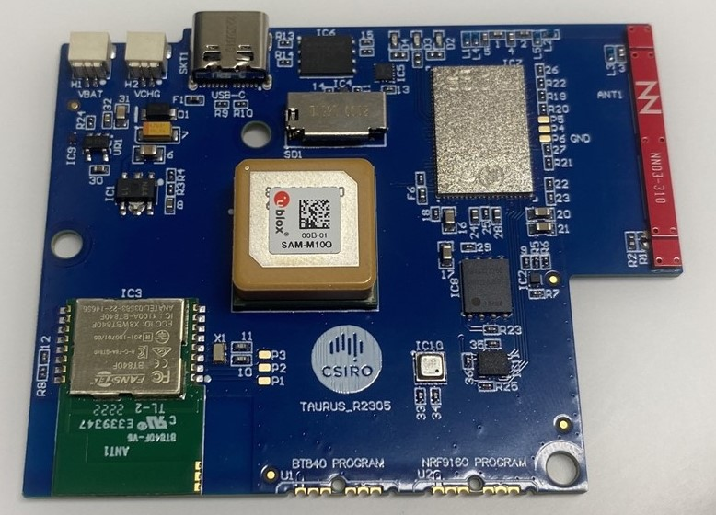
Sensors for monitoring
TAURUS
Location/GPS/Antenna
IMU – Acc/Gyro
Humidity/Temp/Pressure

Slide 8
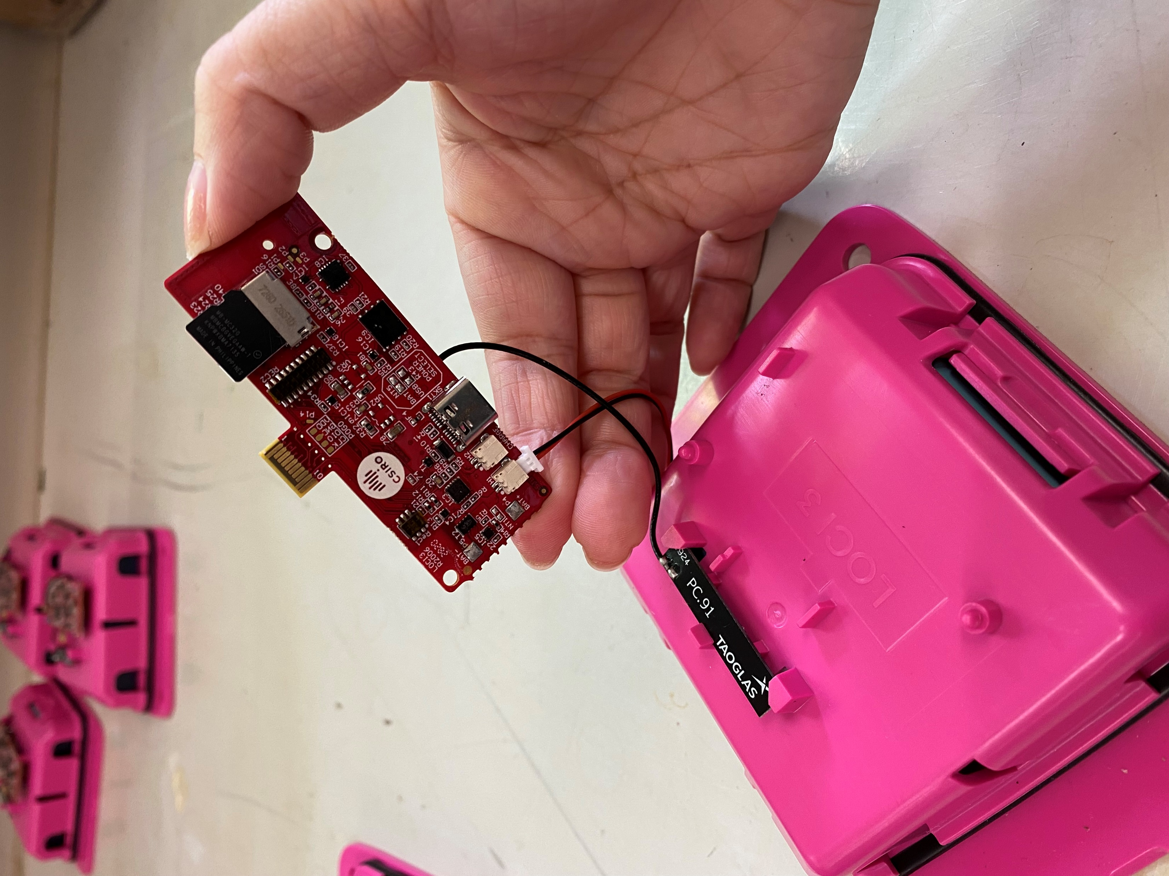
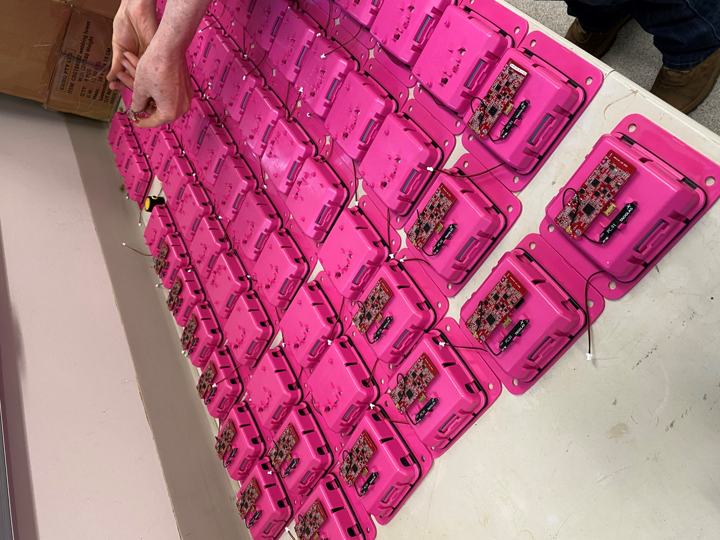
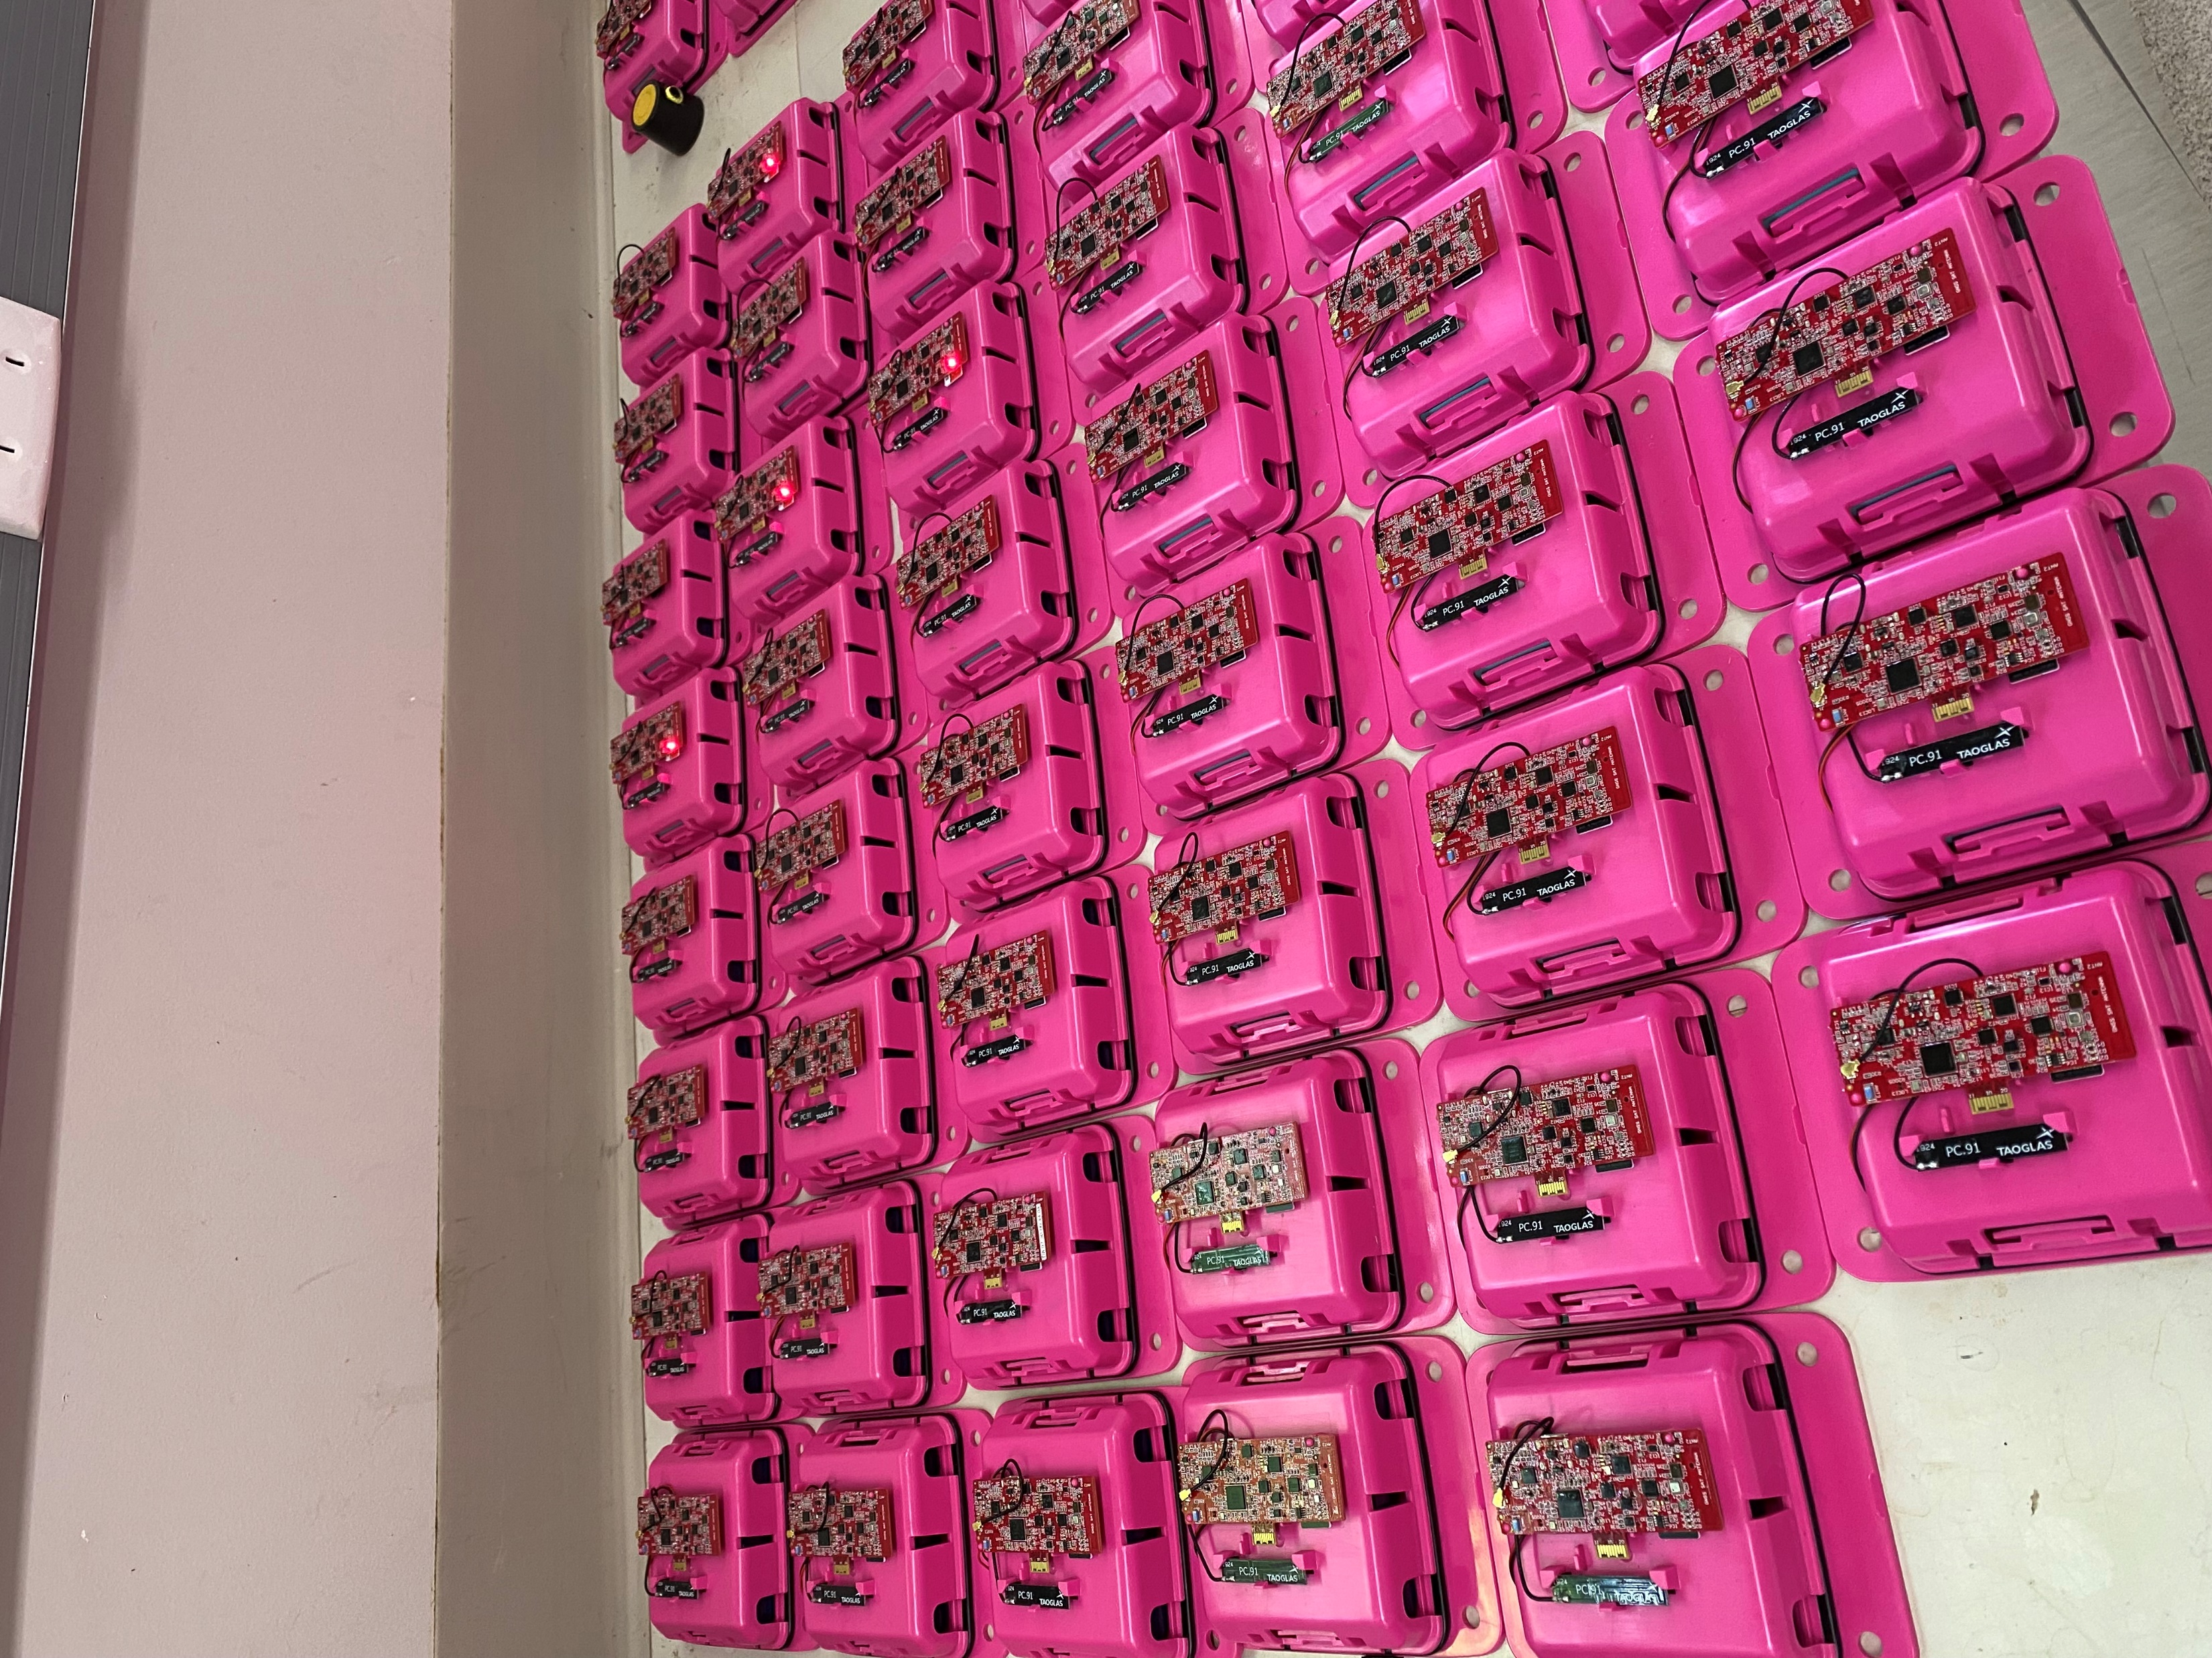
Fun Time at Lab

Slide 9
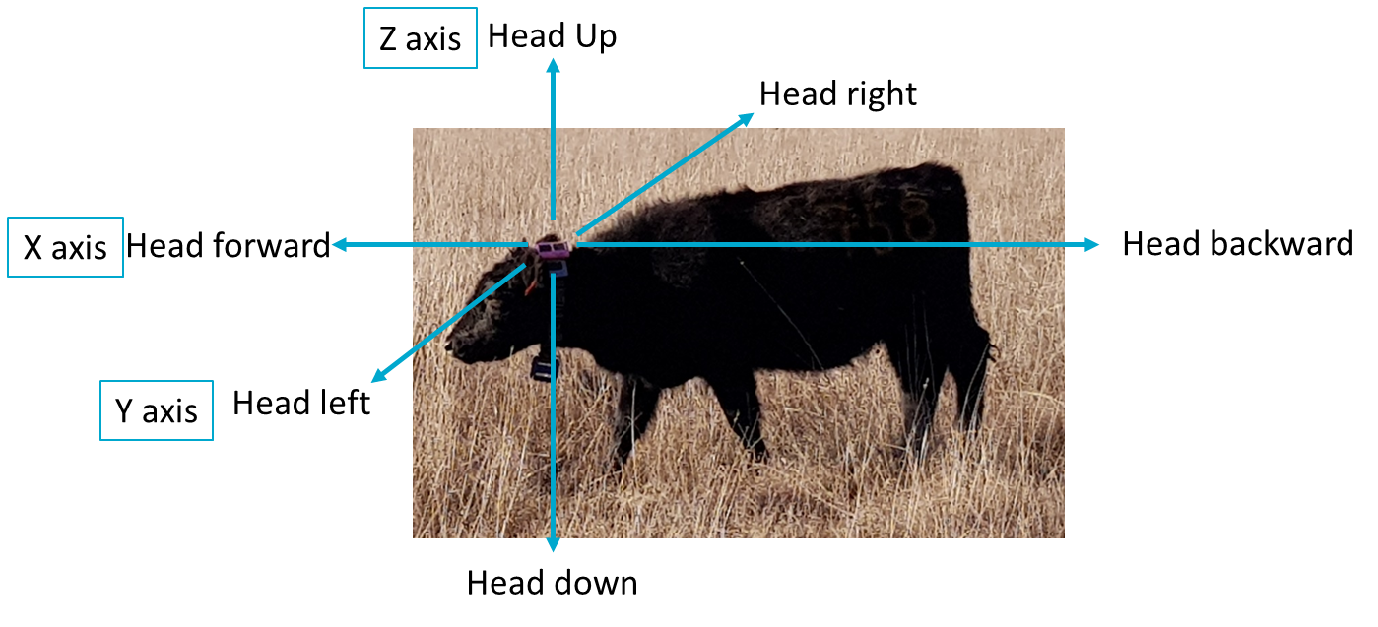
Head Movement
Three-axes accelerometer

Slide 10
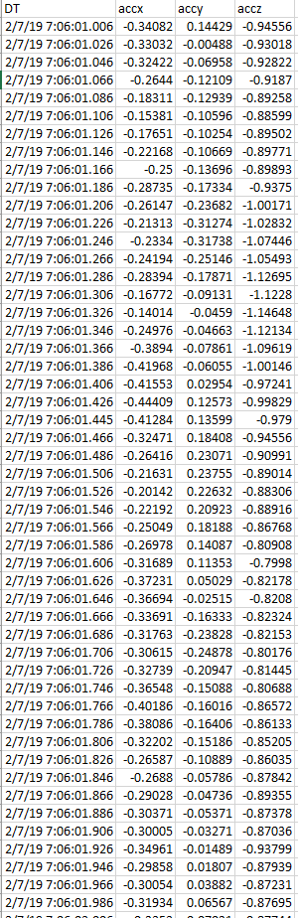
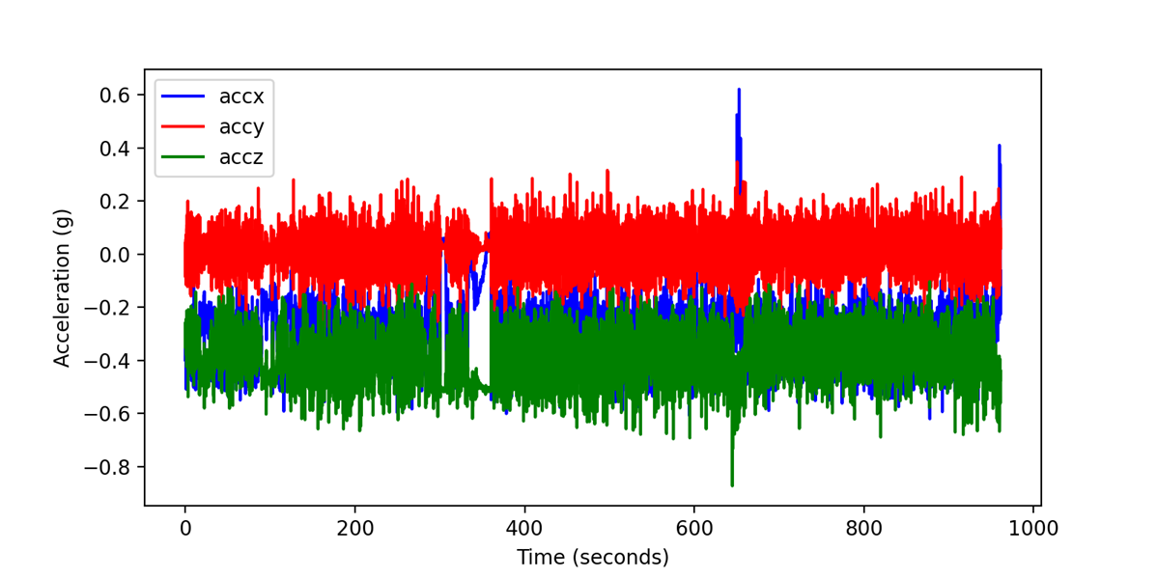
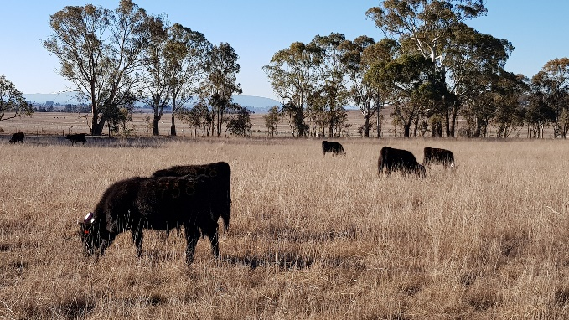
Analytical Challenges
Large volume Data: 50 sample readings per second
Noisy Data
How to present data in a meaningful way?
How to associate measures to animal welfare outcomes?

Slide 11
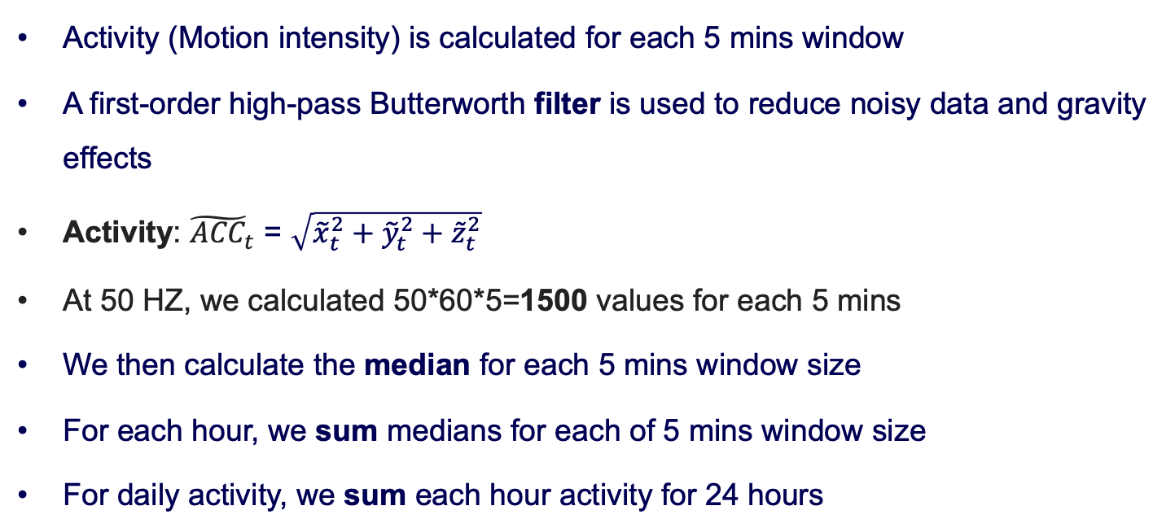
Activity Metric
Activity (Motion intensity) is calculated for each 5 mins window
A first-order high-pass Butterworth filter is used to reduce noisy data and gravity effects
Activity: ${\tilde{ACC}}_{t}$ = $\sqrt{{\tilde{x}}_{t}^{2}+{\tilde{y}}_{t}^{2}+{\tilde{z}}_{t}^{2}}$
At 50 HZ, we calculated 50*60*5=1500 values for each 5 mins
We then calculate the median for each 5 mins window size
For each hour, we sum medians for each of 5 mins window size
For daily activity, we sum each hour activity for 24 hours

Slide 12
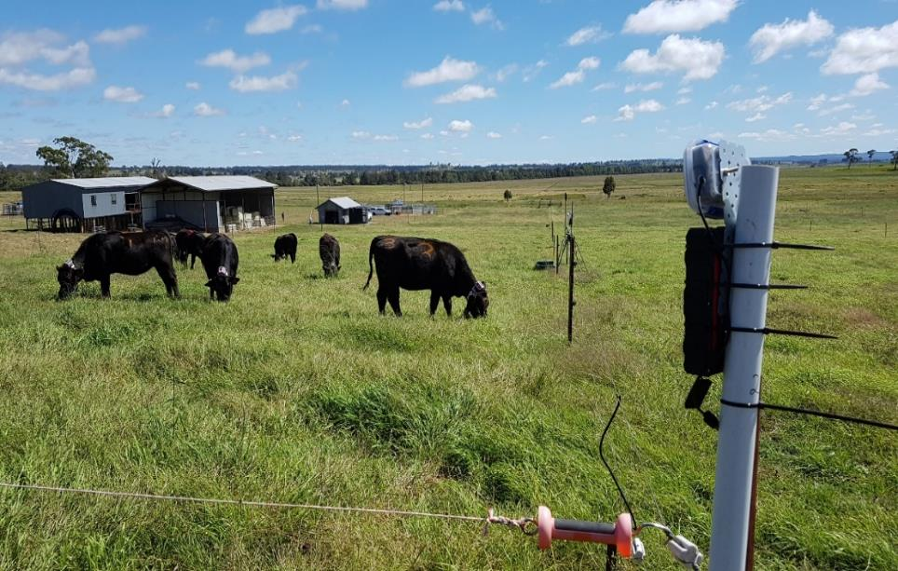
Collect synchronized annotation data
Video
4 corners of paddock
GPS on camera
GoPro
8 hours

Slide 13
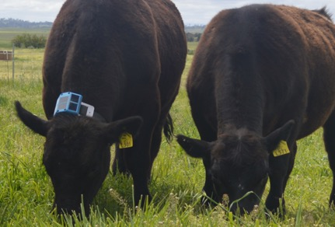
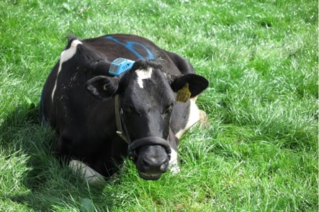
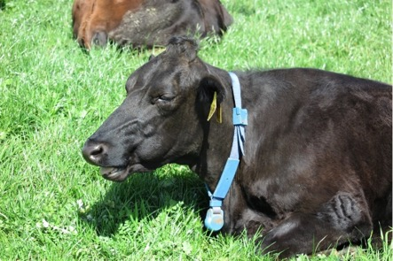
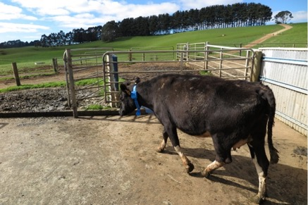
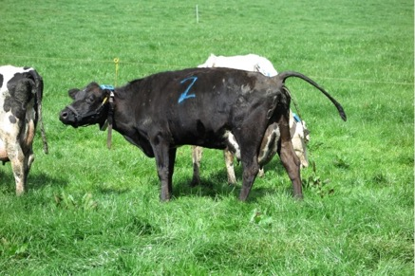
Cattle Behaviors
Grazing
Resting
Ruminating
Drinking
Walking
Other

Slide 14
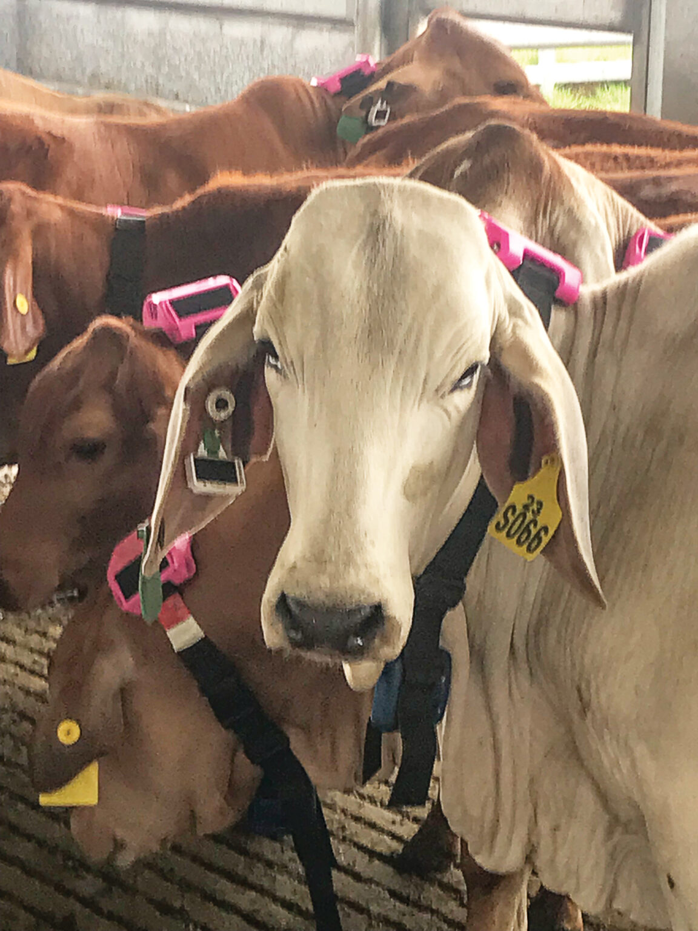
2022 Experiment Description
Device: eGrazor Collar
Frequency: 50 HZ
32GB micro-SD flash memory card
Location: Gatton, Queensland, Australia
Time: November 21 to December 19, 2022
Breed: 60 Brahman or Droughtmaster steers
The live weight data were collected weekly.

Slide 15
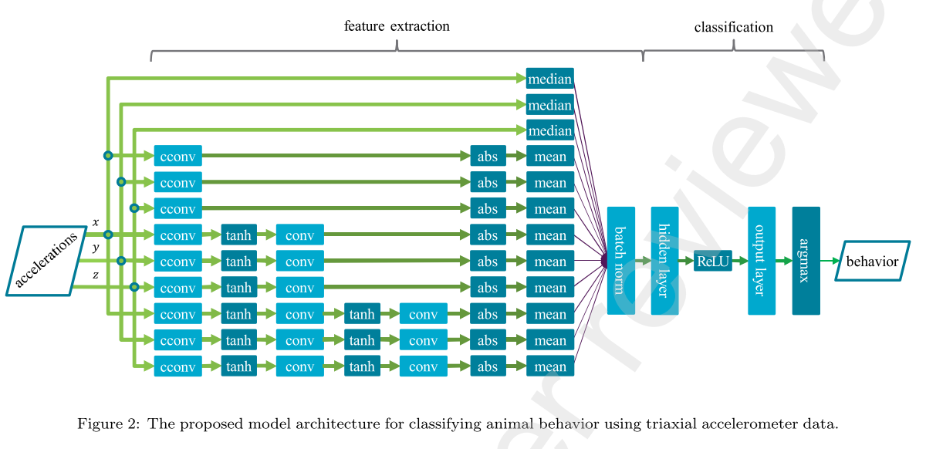
Constrained Convolutional Neural Network
Arablouei, Reza and Bishop-Hurley, Greg and Bagnall, Neil and Ingham, Aaron, Cattle Behaviour Recognition from Accelerometer Data: Leveraging In-Situ Cross-Device Model Learning. https://www.sciencedirect.com/science/article/pii/S0168169924009372

Slide 16
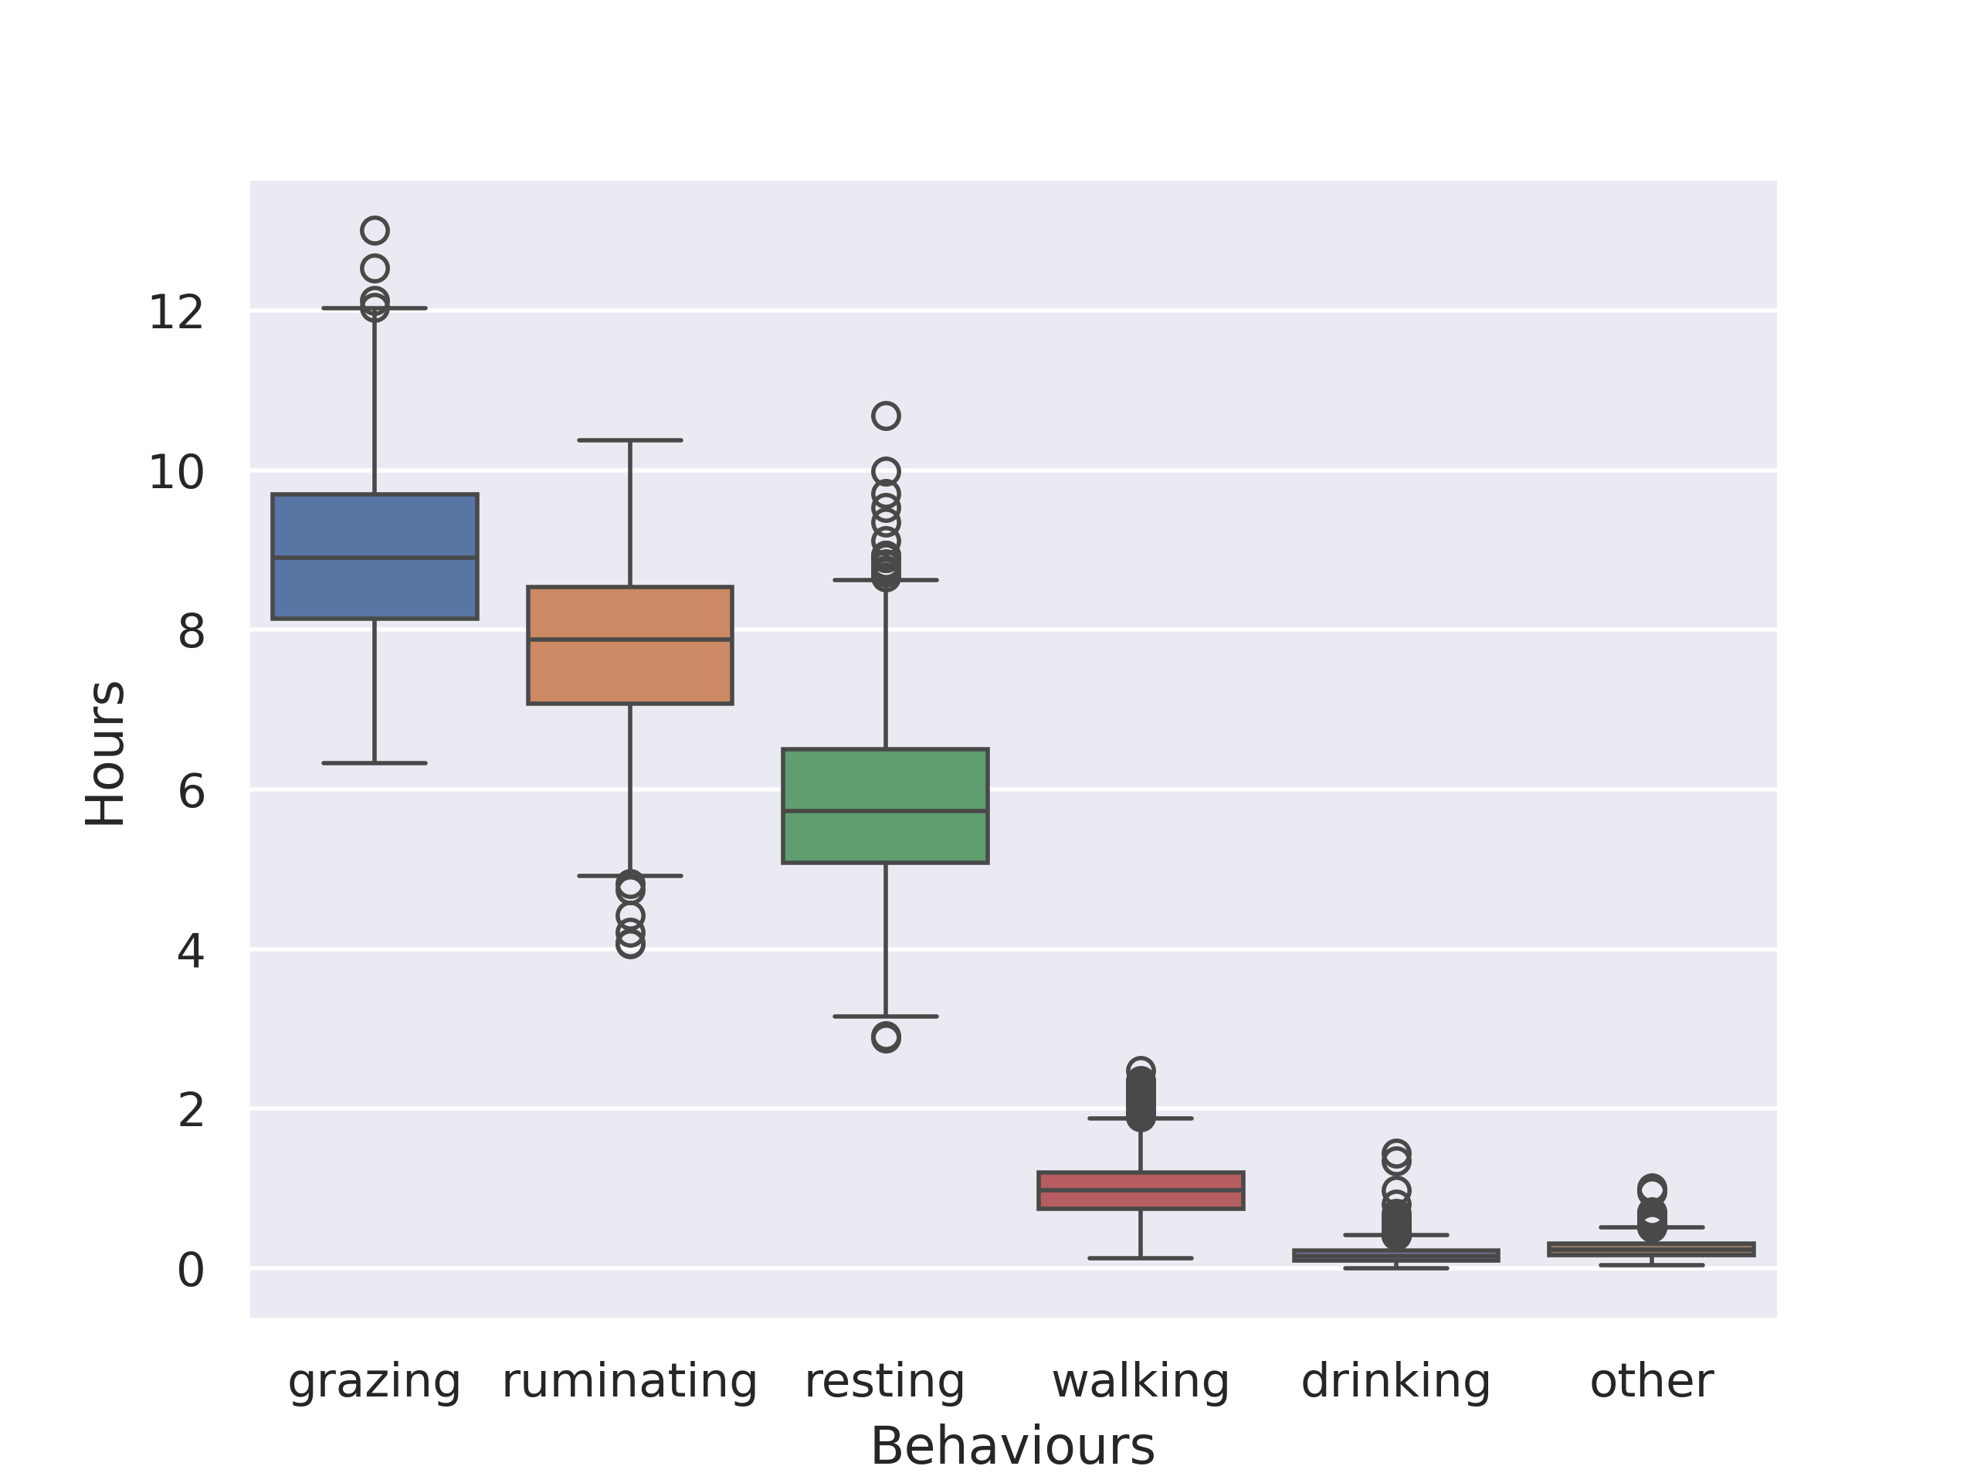
Behaviour Classification Accuracy
MCC0: 0.8891 ± 0.0010 (grazing) MCC1: 0.8573 ± 0.0082 (walking) MCC2: 0.8414 ± 0.0014 (ruminating) MCC3: 0.8455 ± 0.0012 (resting) MCC4: 0.6561 ± 0.0169 (drinking) MCC5: 0.1134 ± 0.0102 (other)
Matthews correlation coefficient (MCC): 0.8378 ± 0.0011

Slide 17
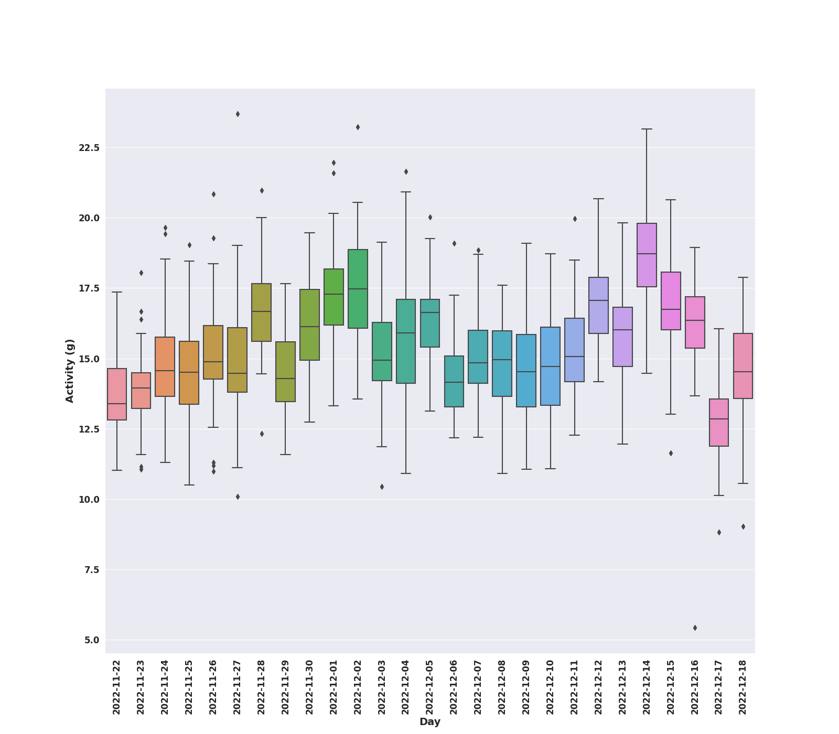
Daily Activity
Notes:
57 animals
27 days

Slide 18
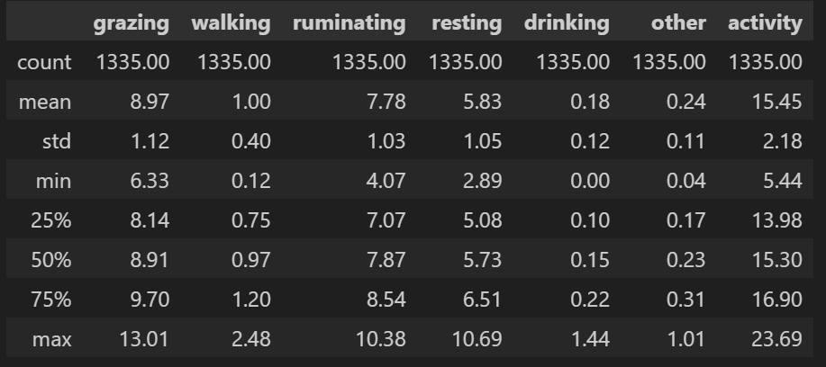
Daily Behaviours Time Vs Daily Activity

Slide 19
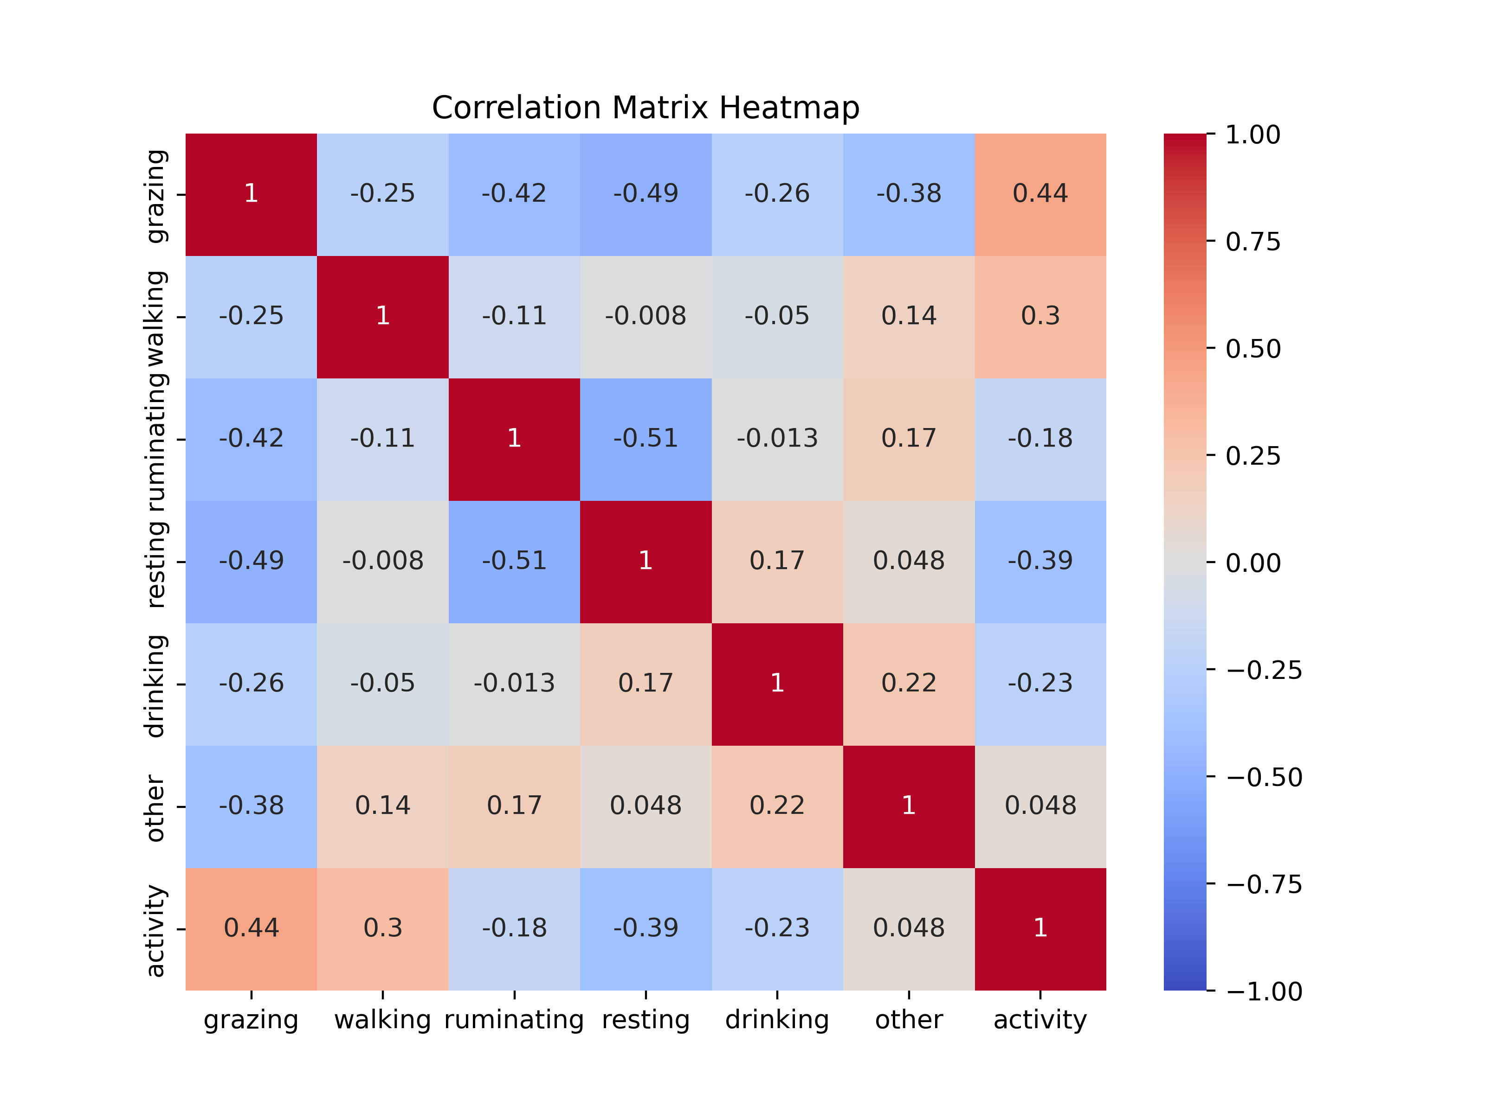
Pearson Correlations

Slide 20
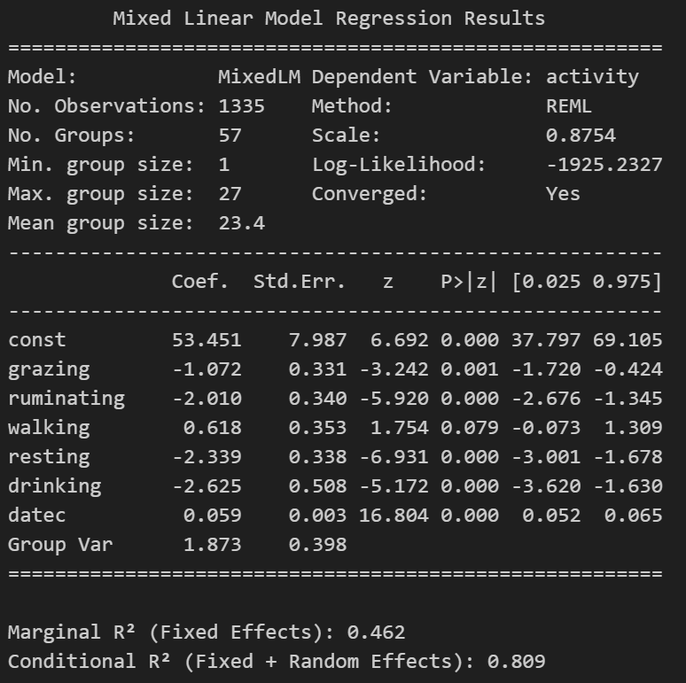
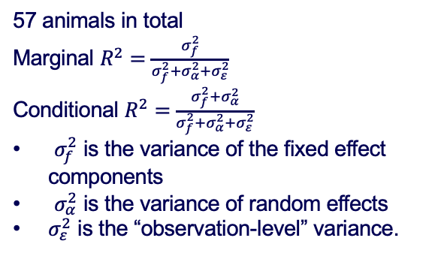
Linear Mixed Model
57 animals in total
Marginal $R^{2}=\frac{σ_{f}^{2}}{σ_{f}^{2}+σ_{α}^{2}+σ_{ε}^{2}}$
Conditional $R^{2}=\frac{σ_{f}^{2}+σ_{α}^{2}}{σ_{f}^{2}+σ_{α}^{2}+σ_{ε}^{2}}$
$σ_{f}^{2}$ is the variance of the fixed effect components
$σ_{α}^{2}$ is the variance of random effects
$σ_{ε}^{2}$ is the “observation-level” variance.

Slide 21
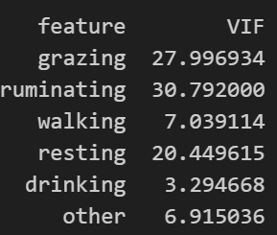
Check Multicollinearity
Variance Inflation Factor (VIF)
If VIF > 4, further investigation is required
If VIF > 10, there is significant multicollinearity that needs to be corrected.

Slide 22
Principal Component Analysis
6 behaviours: 'grazing', 'ruminating', 'walking', 'resting’, ‘drinking’, ‘other’
6 components: PC1, PC2, PC3, PC4, PC5 and PC6
The explained variance for 6 components:
[0.489, 0.933, 0.991, 0.997, 1., 1.]
We choose 3 components as the independent variables in linear mixed model

Slide 23
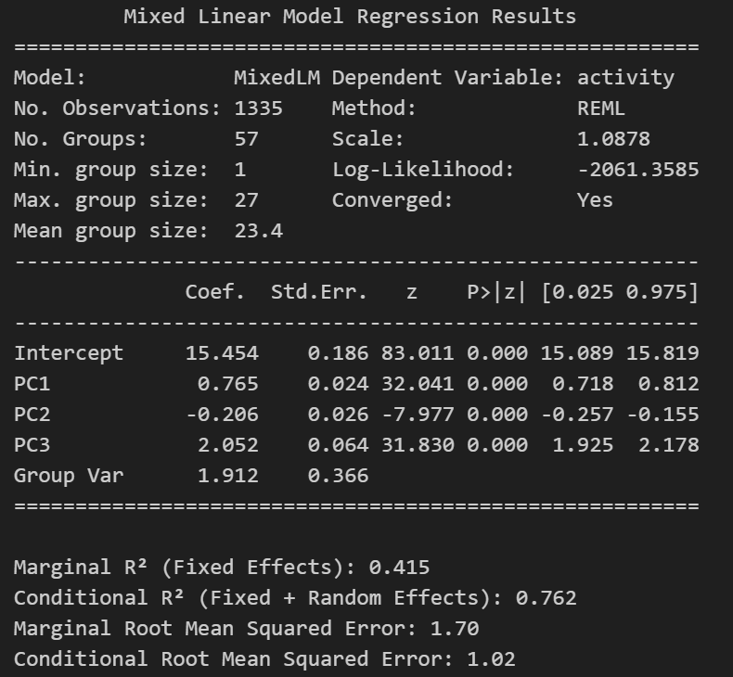
LMM with PCA

Slide 24
PCA Results
Activity ~ 15.454 + 0.765*PC1 - 0.206*PC2 + 2.052*PC3 + 1.912*id + error
PC1 = 0.772*grazing - 0.044*ruminating - 0.051*walking -0.631*resting - 0.023*drinking - 0.023*other
PC2 = -0.346*grazing + 0.806*ruminating + 0.002*walking -0.48*resting + 0.018*other
PC3 = -0.24*grazing - 0.31*ruminating + 0.852*walking - 0.343*resting - 0.001*drinking + 0.042*other

Slide 25
Daily Live Weight Gain
The live weight data were collected weekly.
The average daily weight gain is calculated for each animal.
The aim is to use the sensor-based features (daily behavior time and daily activity) to predict daily weight gain.
Weather information include Minimum and Maximum Temperature, Rainfall and Wind Speed
Five-fold cross validation using machine learning algorithm

Slide 26
Predictions for daily weight gain
100 repeats
 | RMSE | R-squared
Linear Regression | 0.8668 | 0.4667
Decision Tree | 1.0866 | 0.0950
Random Forest | 0.8705 | 0.4703
Support Vector Regression | 1.1155 | 0.1480
XG Boost | 0.8984 | 0.4359
Neural Network | 0.8834 | 0.4431

Slide 27
Take Home Messages
On-animal sensors such as accelerometers have been widely and successfully used to classify cattle behaviours.
Accelerometers are used to collect high-frequency data on activity of animals in real-time.
Different behaviours would cause different movements and further need different energy budgets.
Grazing and walking are positively correlated with activity scores, whereas ruminating and resting are negatively correlated with activity scores.
The liveweight gain could not be fully explained by measurements taken in this study, but we showed how these factors can influence the variability in cattle performance.

Slide 28
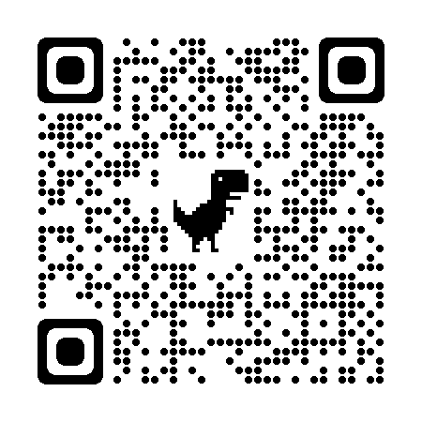
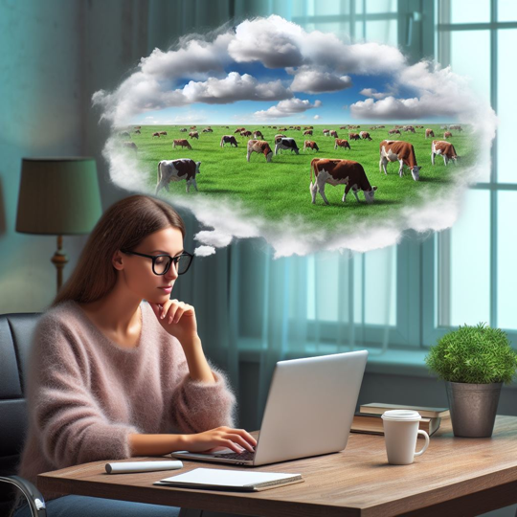
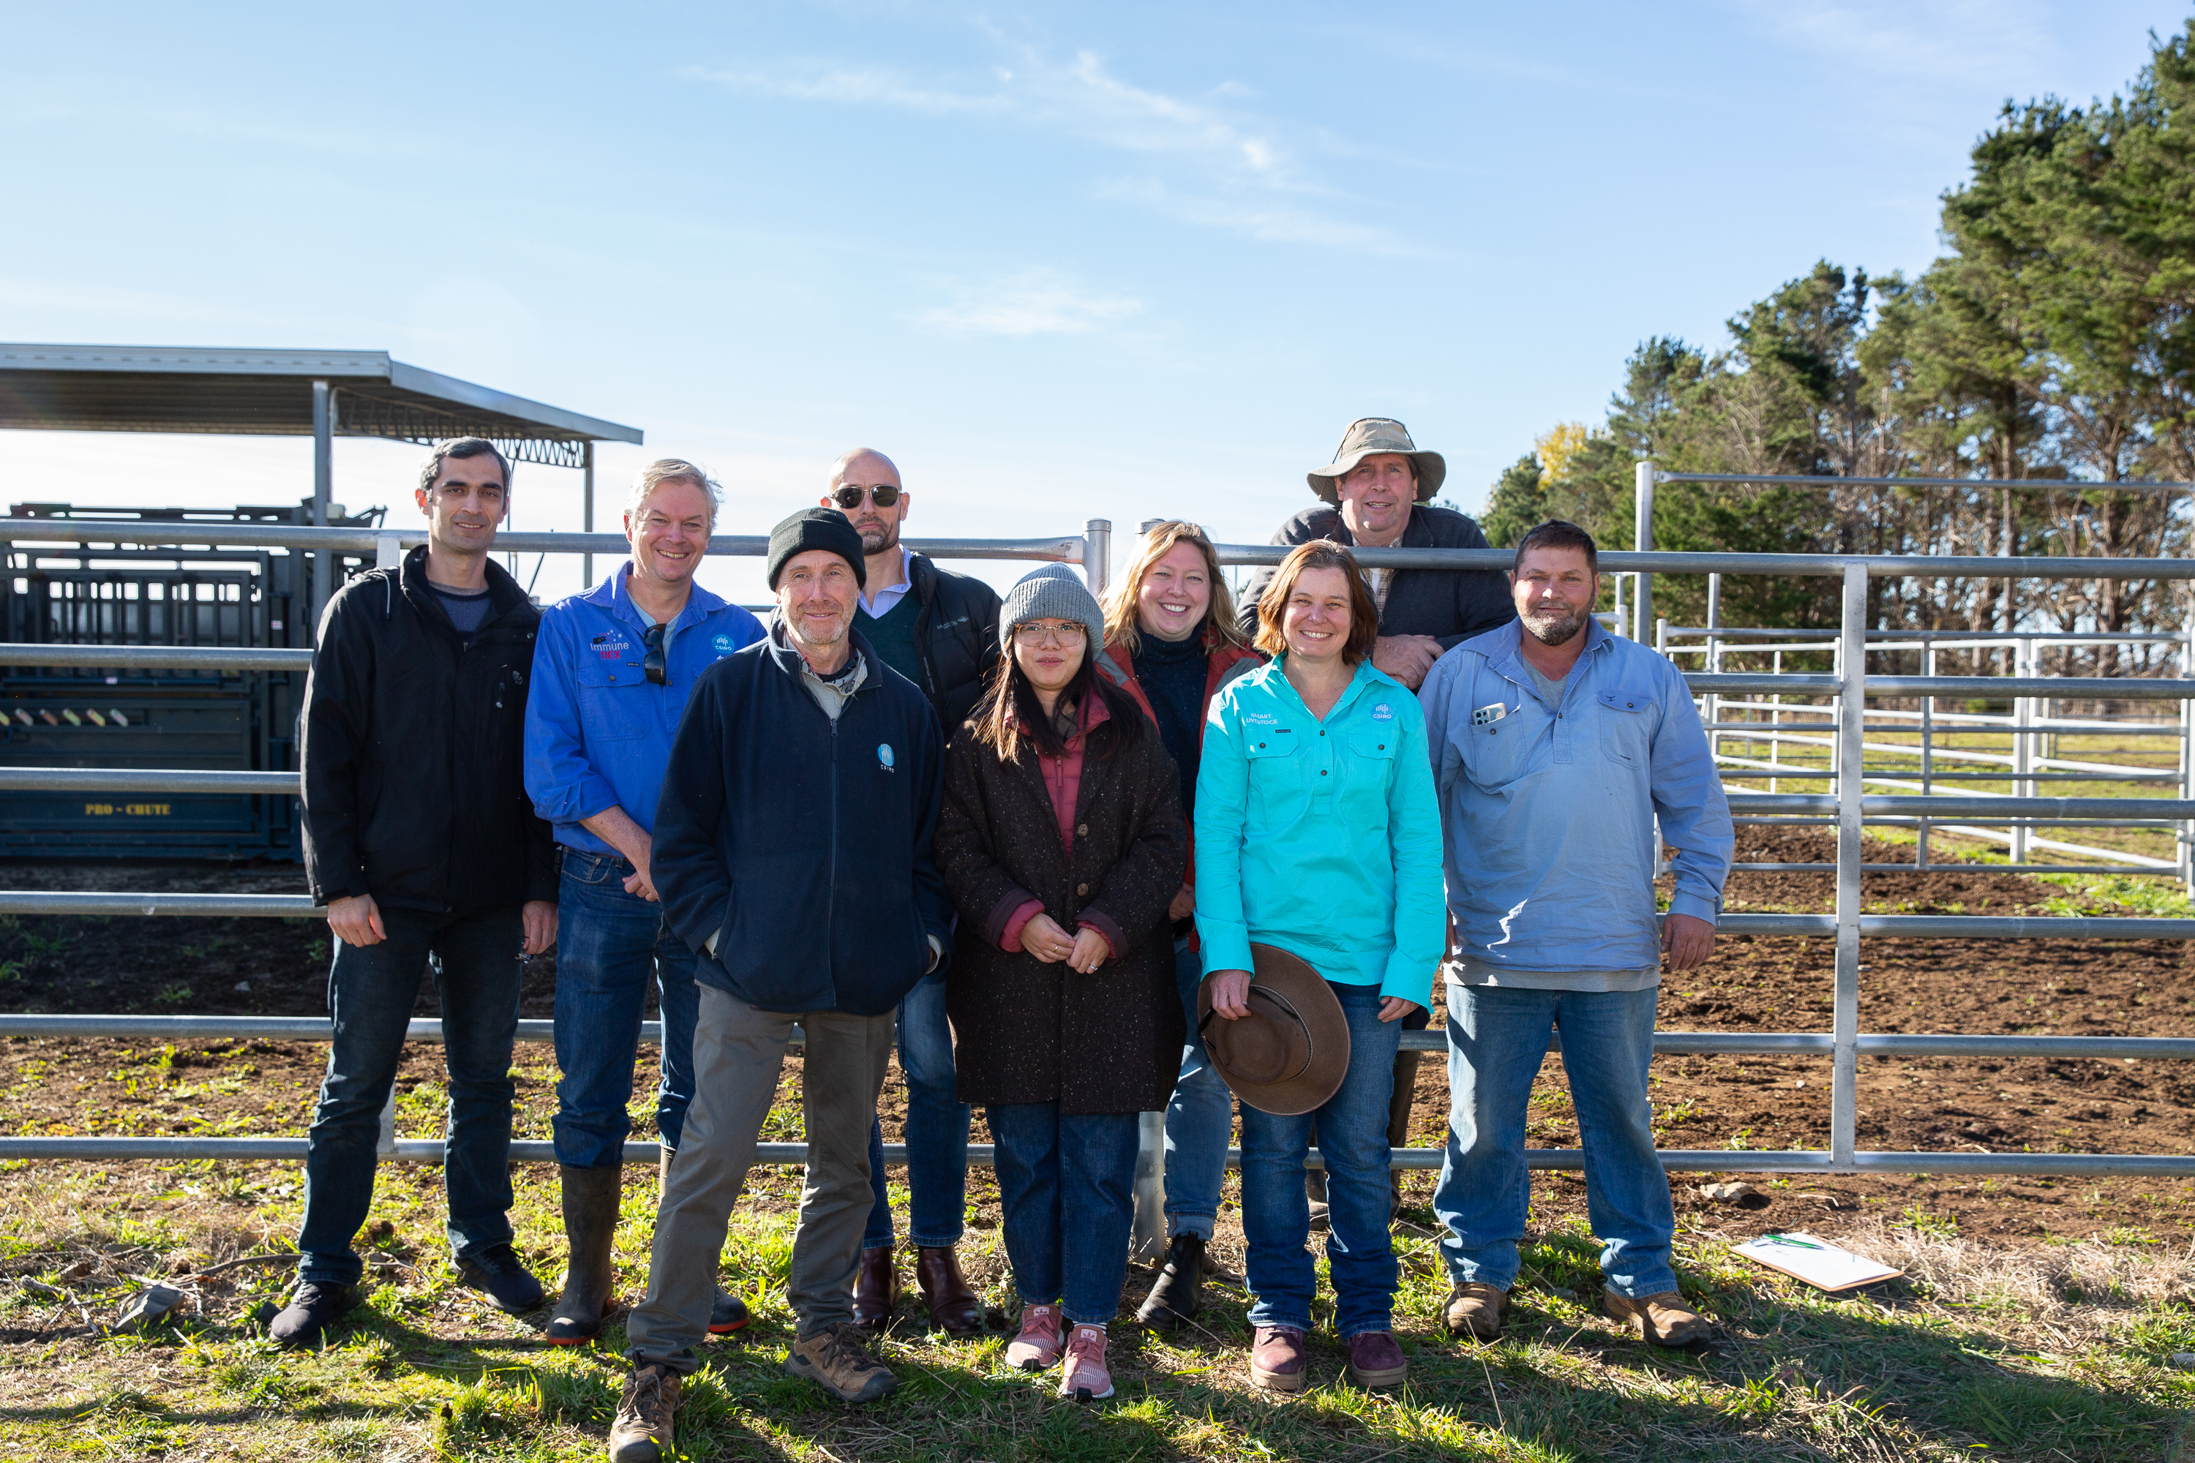
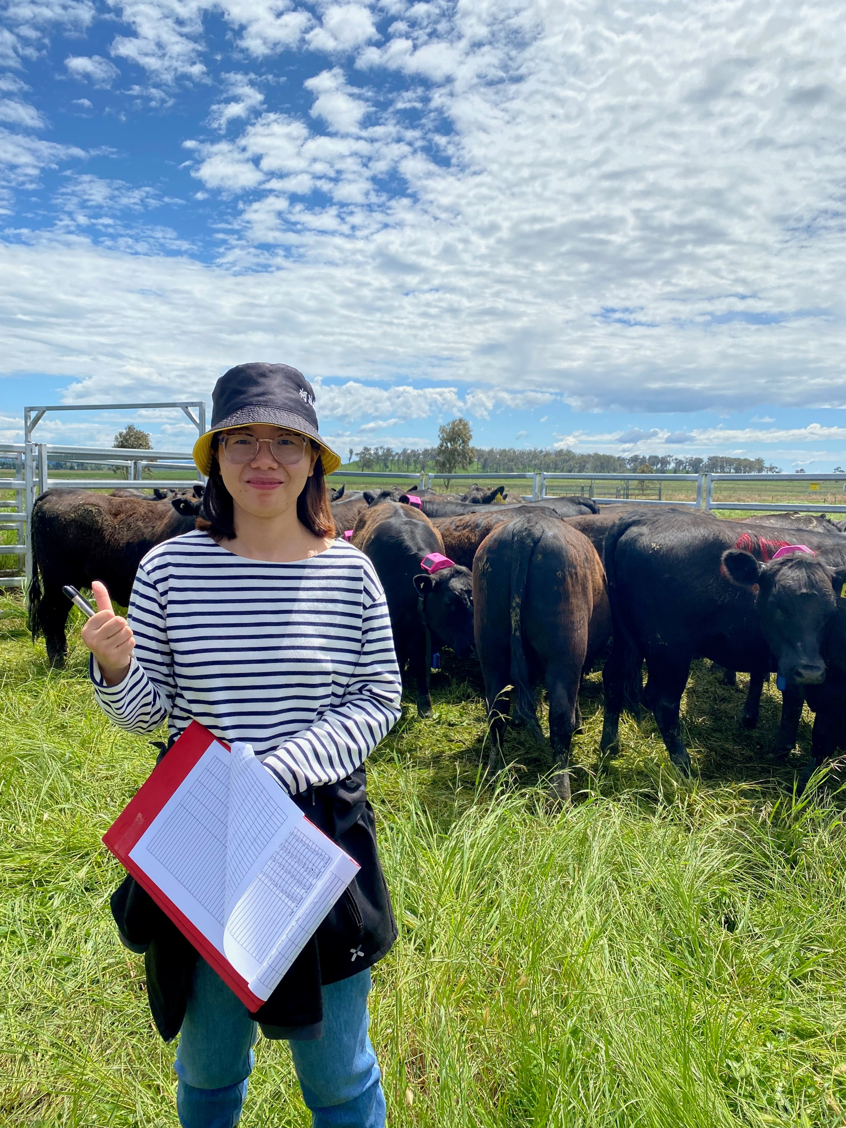
Acknowledgement

